Slide 1
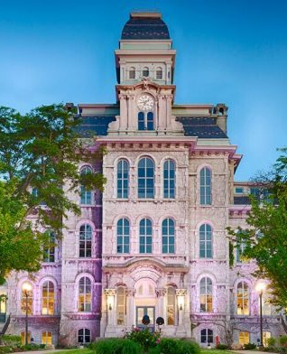

Syracuse University 150 Orientation Spanning Tree
SCM 702
Sihan Yang
Yubin Yuan
Bowen Xia

Slide 2

SU Orientation Spanning Tree
Contents
1
Background Introduction
2
Network Flow Model
3
Solution and Model
4
Limitation
5

Slide 3

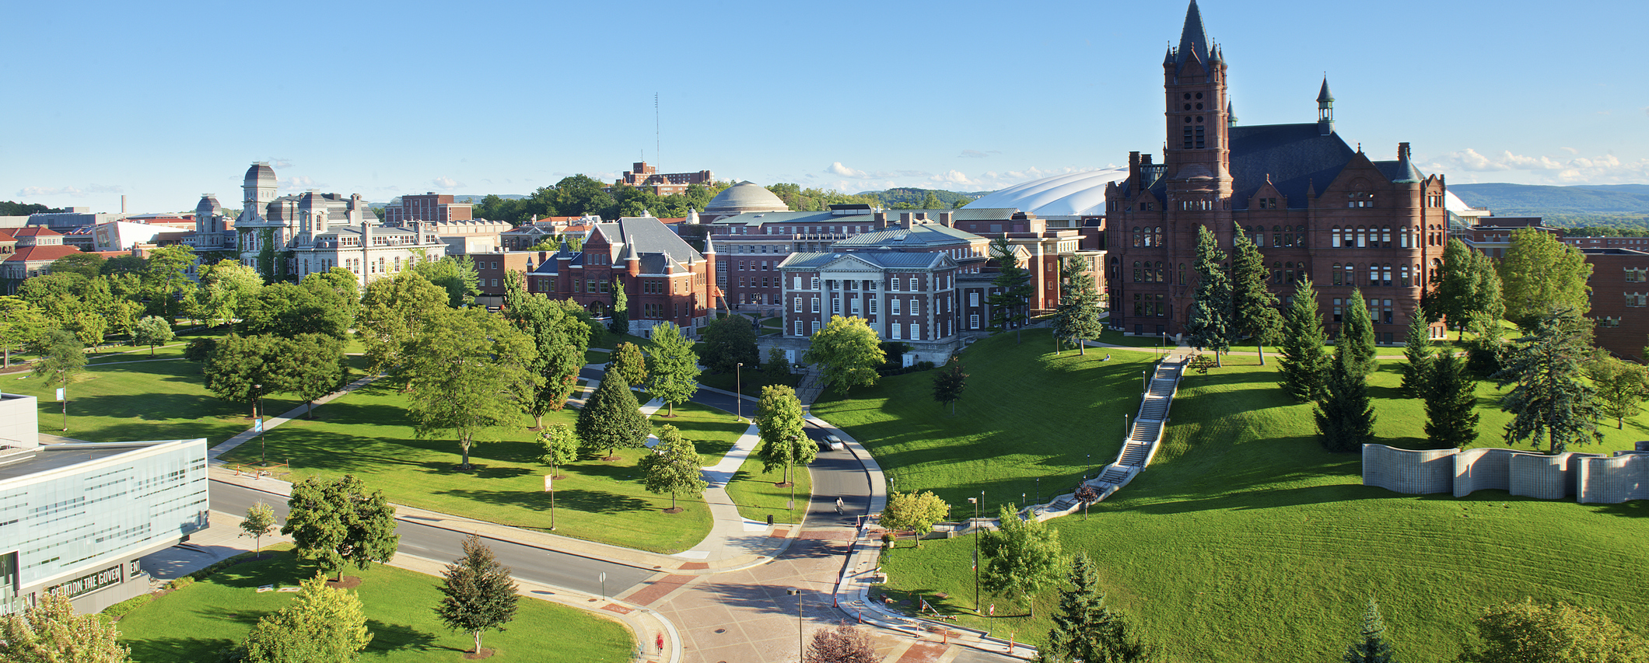

Background Introduction
/01
Project Incentive
Project content

Slide 4

Background Introduction
Project Incentive
It is the 150 year of Syracuse University. As a graduate student, we would like to build a minimal spanning tree for students, family and tourists to visit all colleges in the shortest time.
=
2018
REORT
Buildings been selected
Buildings been selected
Martin J. Whitman School of management
University College
School of education
S.I. Newhouse School Of Public Communications
The graduate school
School of Architecture
College of law
l.c. smith college of engineering and computer science(link hall)
School of Information Studios(hinds hall )
College of Arts and sciences
Maxwell School of Citizenship and Public Affairs
College of Visual and Performing Arts
David B. Falk College of Sport and Human Dynamics

Slide 5
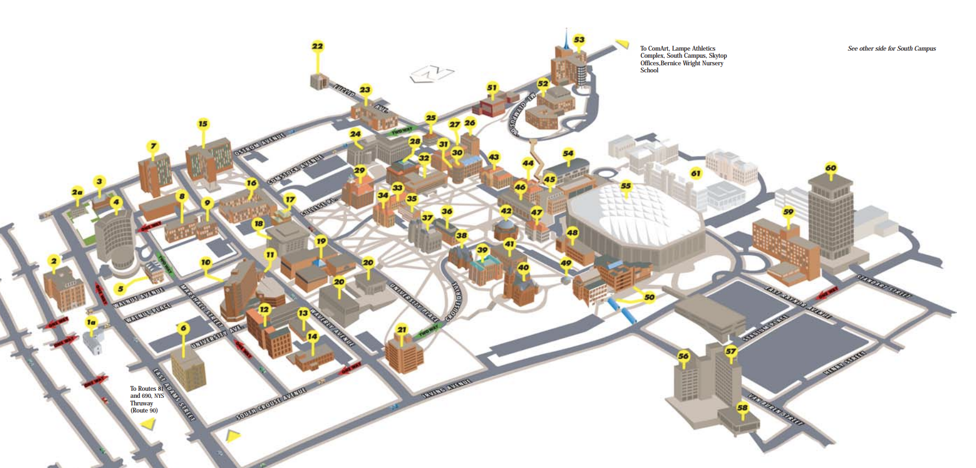
Background Introduction

Slide 6
Network Flow Models
/02
Network Components
Model selection
Traveling Salesman Problem (TSP)

Slide 7

Network Components
Nodes
Branches
SU has13 different colleges covers 1,214 acres. Therefore, 13 Nodes in total.
1
2
Flow between the connected nodes
Represent travel distance
Path
3
4
Distance
Undirect path: two-way traffic
Travel distance between each nodes quoted from Google Map
Unit: Meter

Slide 8
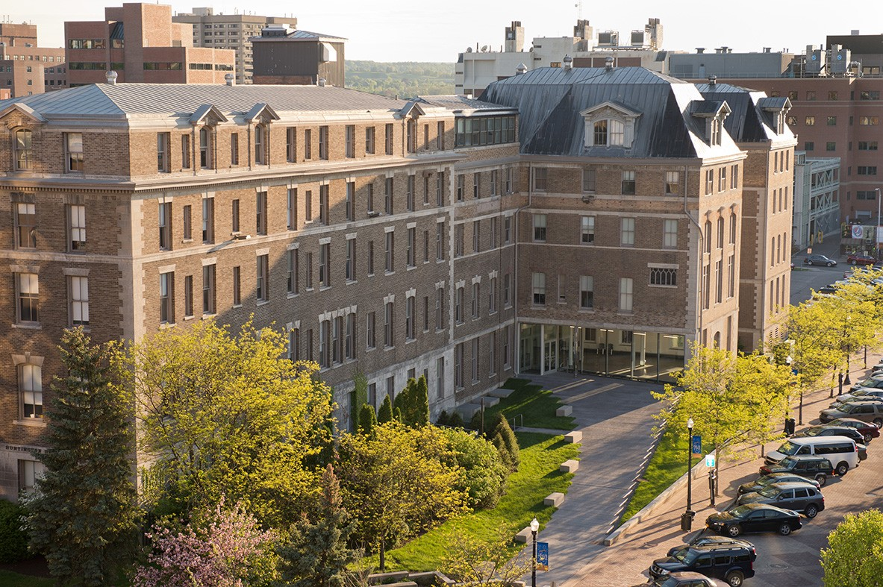
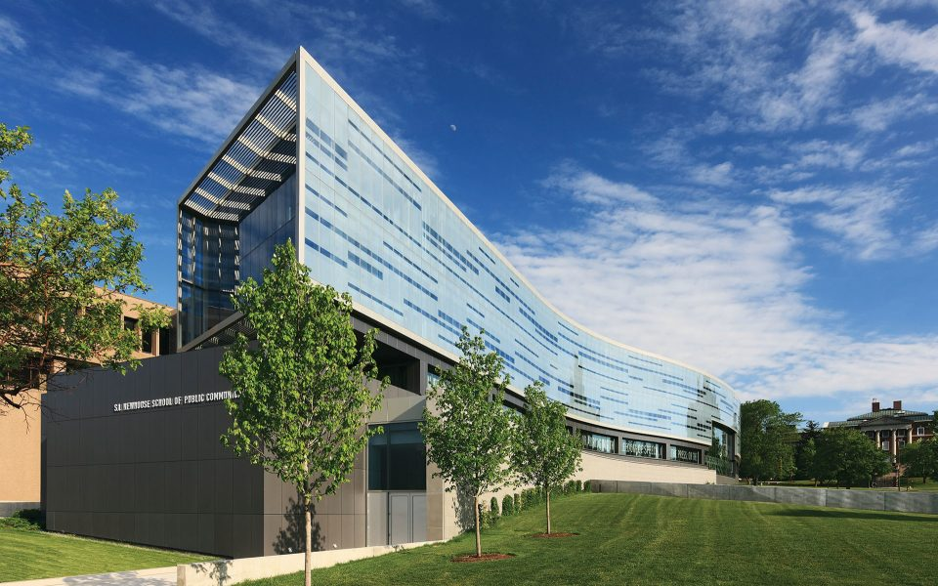
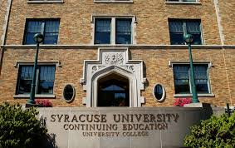
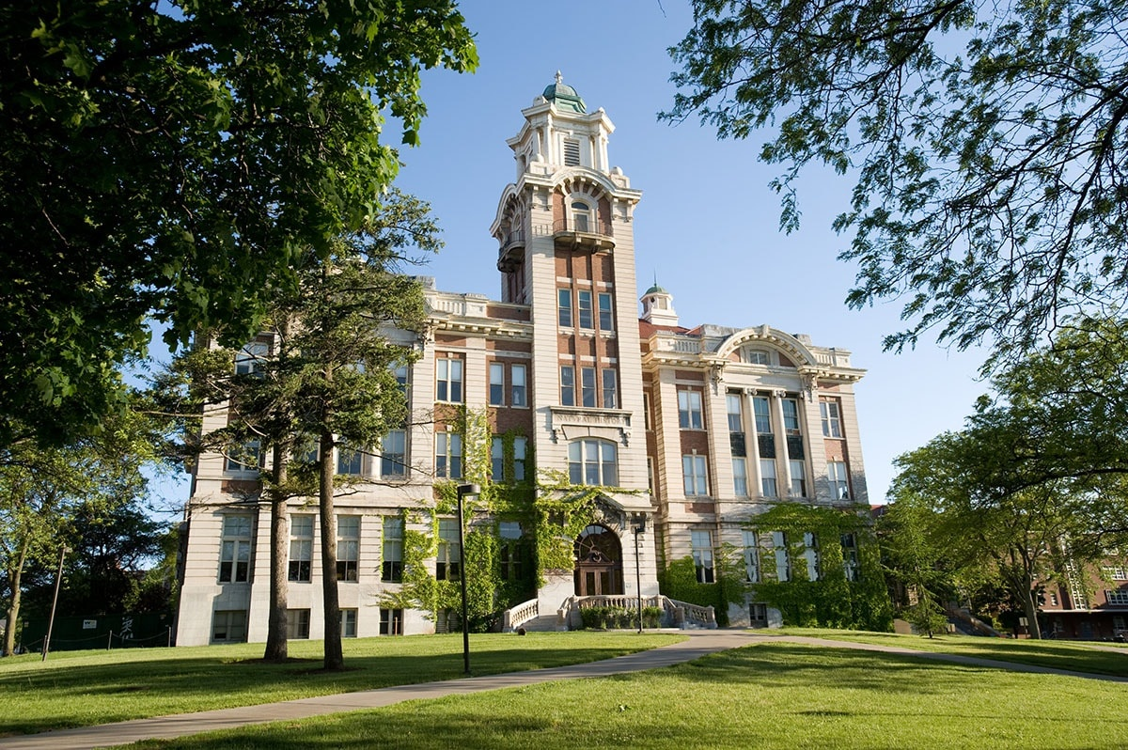
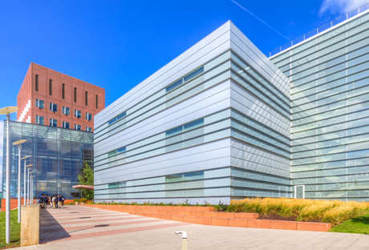
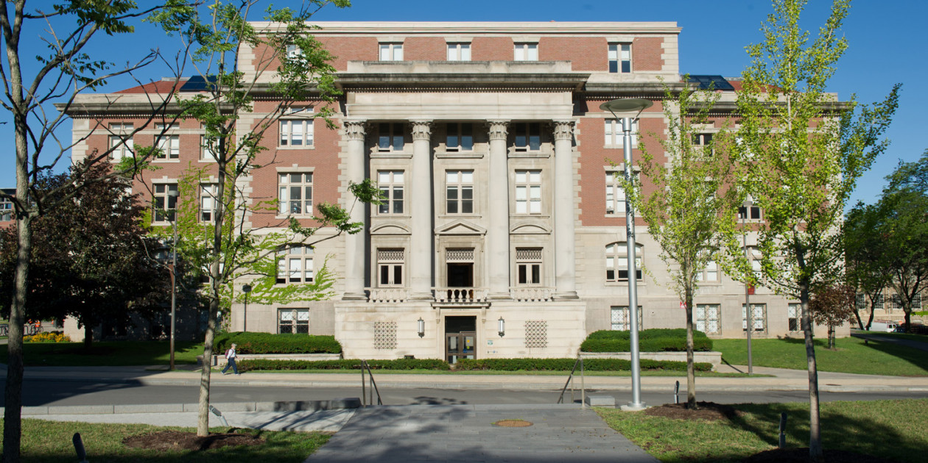
Network Components
School of education
Newhouse
04
03
University College
02
The graduate school
05
Martin J. Whitman School
of management
01
06
School of Architecture

Slide 9
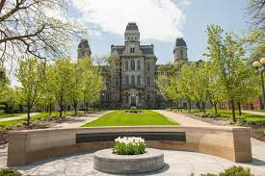
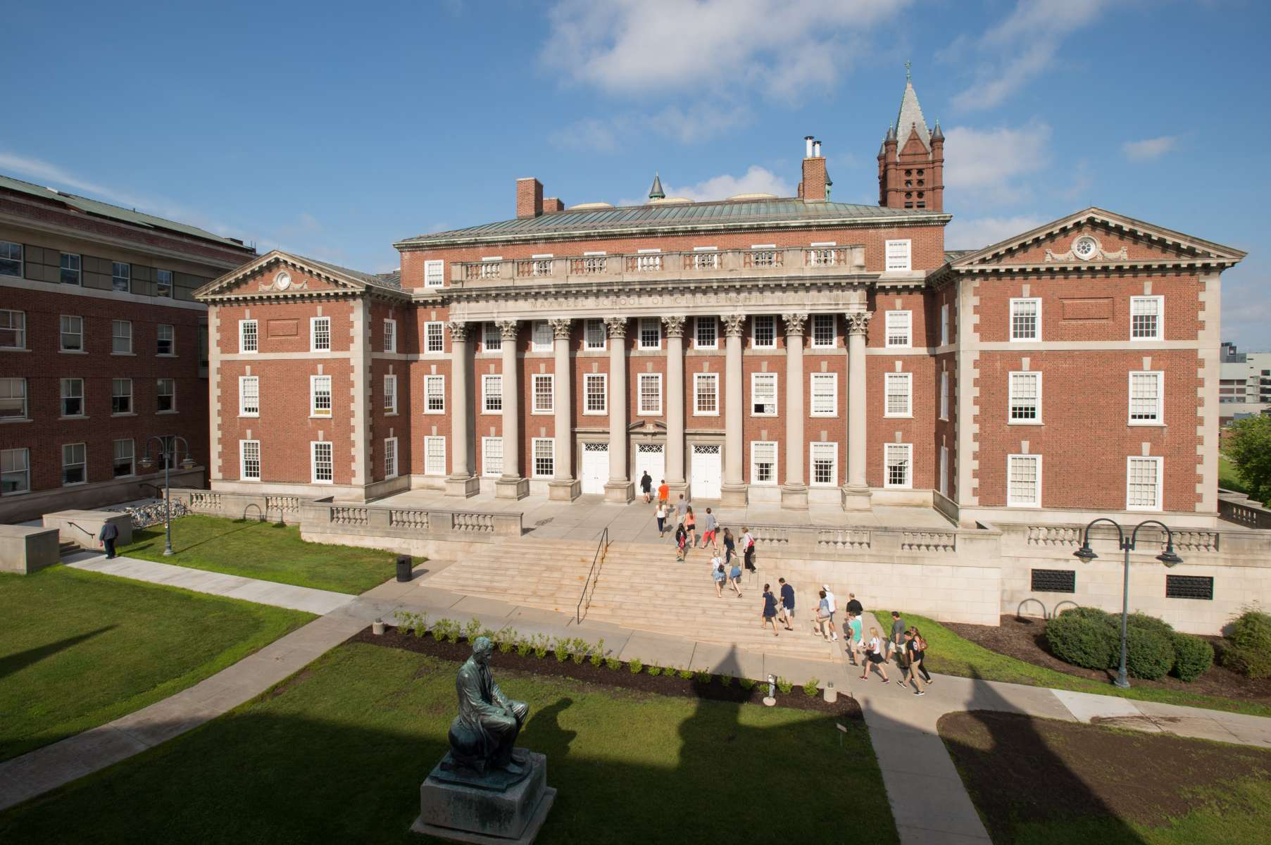
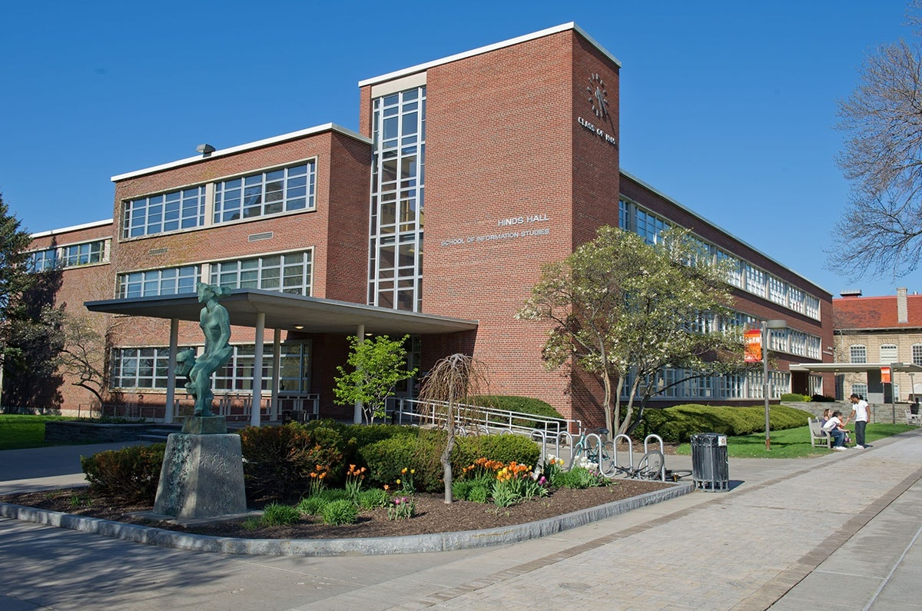
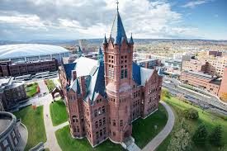
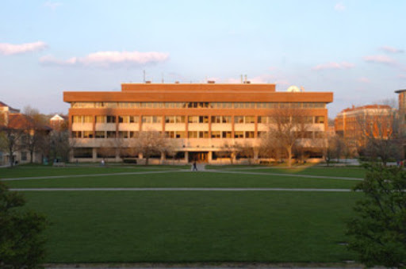
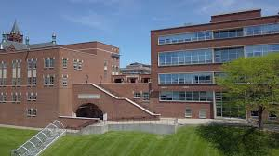
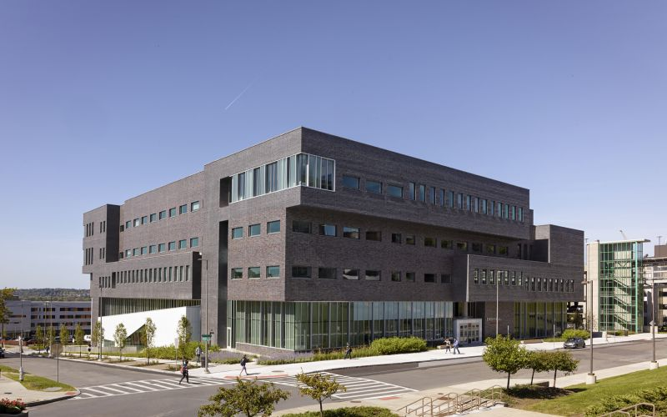
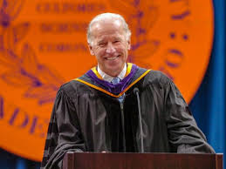
Network Components
College of Arts and sciences
Maxwell
10
iSchool –Hinds Hall
09
08
VPA
11
13
smith college of engineering
& computer science -Link Hall
07
12
Falk College
College of law

Slide 10
Model selection
Minimal Spanning Tree
Can start at any node in the network
Select minimal route
Select the closest node not currently in the spanning tree
Traveling Salesman Problem
Fund the shortest possible route that visits each building once and return to the origin nodes.
Types
Shortest Route
Shortest distance between an originating point and destination points

Slide 11
Traveling Salesman Problem
An NP-hard problem in combinational optimization
TSP where given a length L, the task is to decide whether the graph has a tour of at most L
2020
History
Description
Applications
Mathematically formulated in the 1800s by the Irish mathematician W.R. Hamilton and by the British mathematician Thomas Kirkman.
As a graph problem
Asymmetric and symmetric
Planning
Logistics
Manufacture of microchips

Slide 12
Solution and Model
/03
Networking Flow
Identify the Traveling Salesman Problem (TSP)

Slide 13
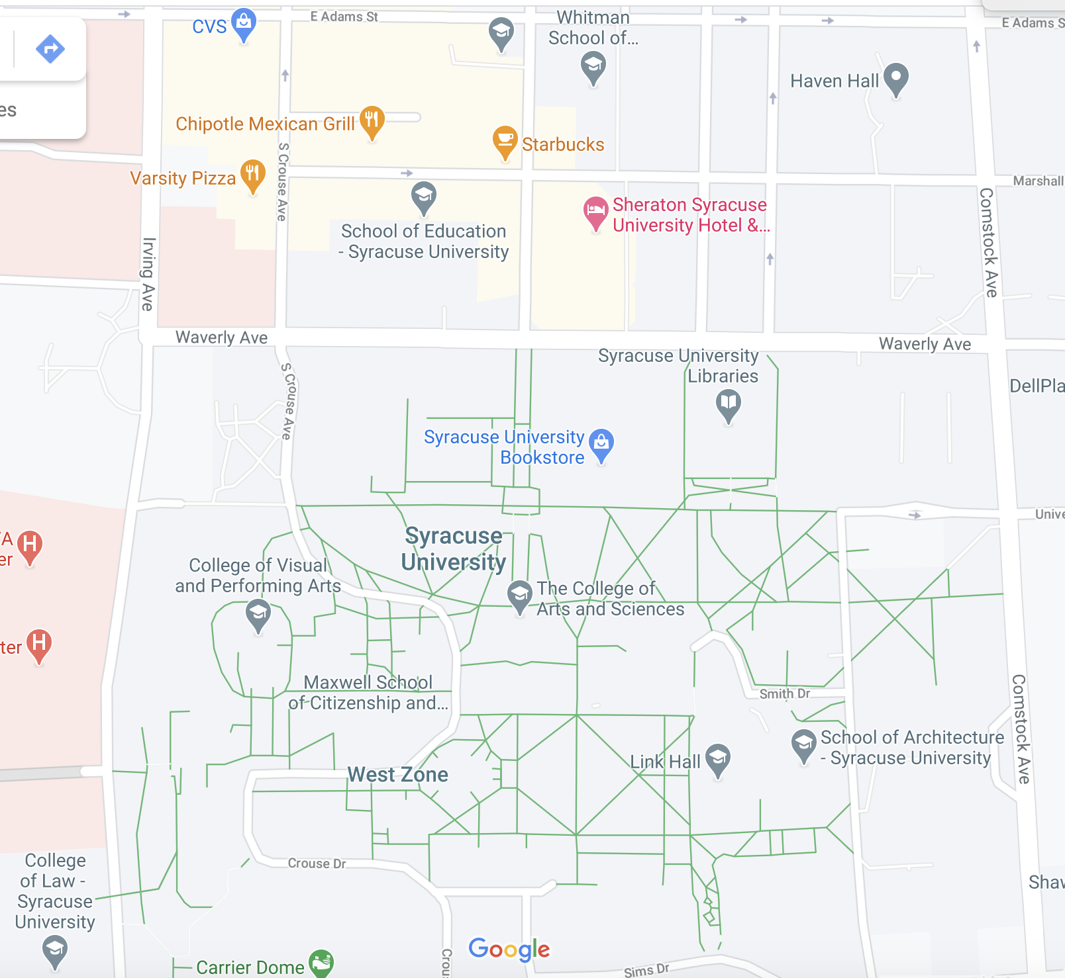
Networking Flow
2
1
3
4
9
11
5
8
12
10
7
6
13

Slide 14
Solution and Model
Decision Variables:
x_{ij} = 1 if i->j is part of the route we’re looking for and 0 otherwise, where i->j is the available branches shown in the network above (for example, since we have both 2->4 and 4->2 available on the network, we need to define both x₂₄ and x₄₂ as the decision variables).
u_{i} is the position of location i on the tour, i=1, …, 13.
Objective Function:
Minimize Z = 130x₁₂ + … +260*x₁₂₁₃

Slide 15
Solution and Model
Subject to:

Slide 16
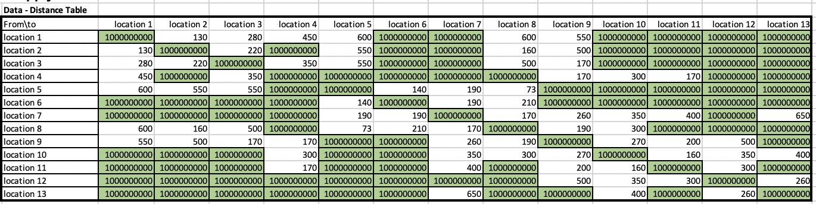
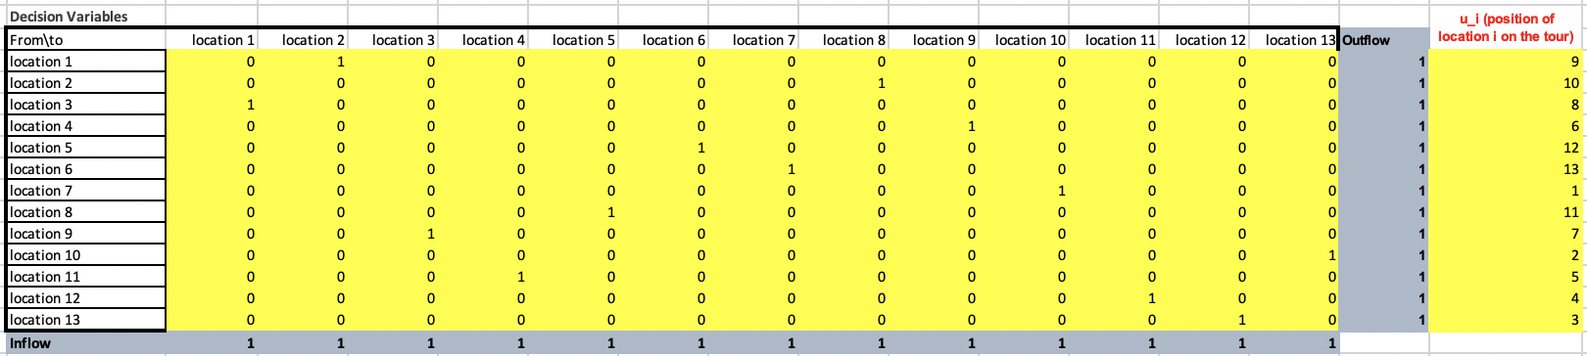
Solution and Model

Slide 17
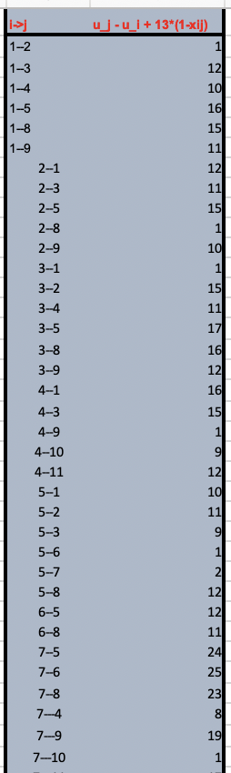
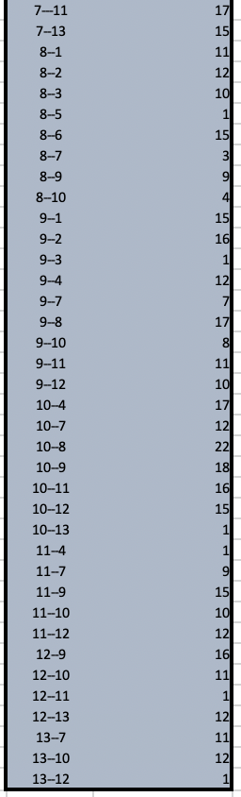
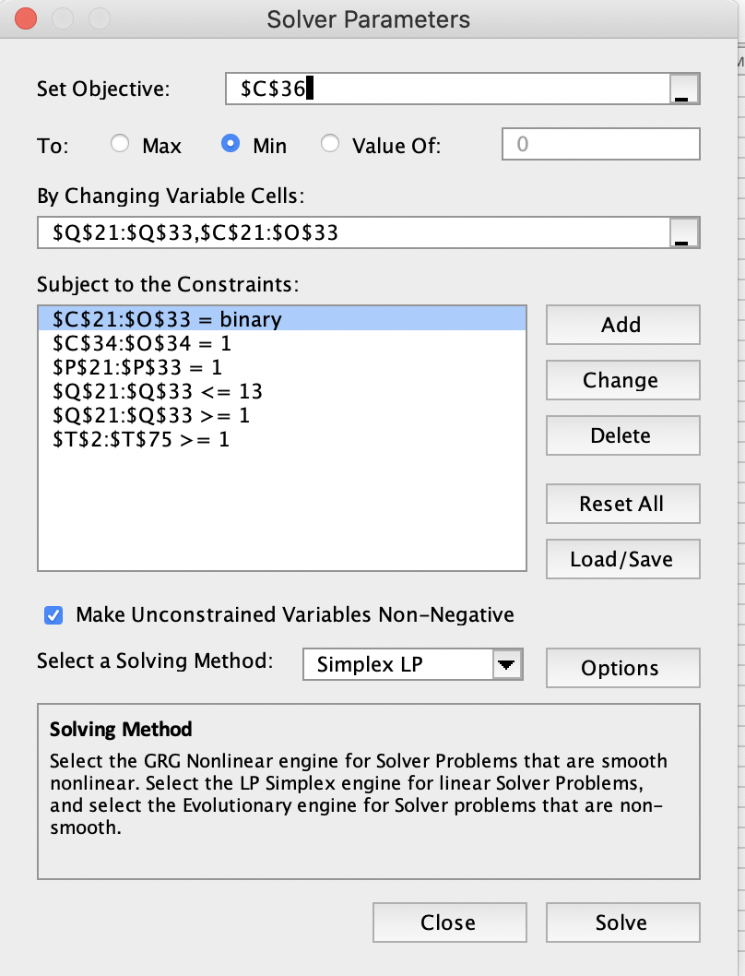
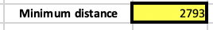
Solution and Model

Slide 18
Networking Flow
2
1
3
4
9
11
5
8
12
10
7
6
13

Slide 19
Limitation
/04
Limitation of TSP

Slide 20
Limitation
Case Sensitive
Number of Nodes
Not suitable to all general problems
Can not have too much nodes
Limitation
Position
Too Complicated
u_{j} – u_{i} + 13(1-x_{ij}) >= 1 can not have too much, excel can not process it.
The model its complicate than other two model that we learned in class

Slide 21
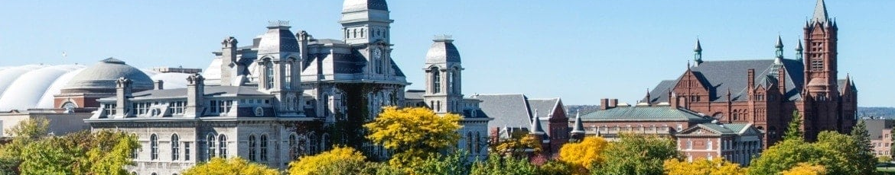

Question?
THANKS

